Slide 1
Creating TV and movie magic with Lenovo
Media & Entertainment
TAT Productions
A production company and digital studio based in France is using Lenovo ThinkSystem servers to bring animated stories to life on TV and cinema screens worldwide. TAT Productions' Lenovo compute clusters empower it to build, render, light, and animate complex 3D scenes and characters faster and more efficiently than ever before.

Slide 2
1
TAT is both a production company and an animation studio specialized in 3D animation for television and cinema. Its flagship property, the International Emmy Award®-winning "Les AS de la Jungle" ("Jungle Bunch"), has enjoyed enormous success since 2011 on screens both large and small in more than 200 territories and 50 languages.
TAT has released five full-length movies in theaters since 2017 and has two further movies and a new TV series currently in production. At the same time, it is creating a major new Netflix animated series, Astérix, directed by Alain Chabat and scheduled for release in 2025.
Who is TAT Productions?

Slide 3
2
The release of full-length features in movie theaters is planned months or even years in advance. Distributors negotiate with theaters to secure the perfect slot, and then run staged marketing campaigns to whip up anticipation and ensure a big opening. Any delay to the original release date could result in contractual penalties and a shorter, less profitable run. Similarly, delaying the release of TV shows can cause major marketing headaches for internet media companies and leave gaps in TV networks' schedules.
For TAT, release deadlines are therefore an ever-present challenge. As the number of concurrent projects grows and as digital tools provide more sophisticated and computationally intensive options, TAT is always under pressure to run more computations. Every second of content comprises between 24 and 60 HD or 4K images, each of which must be designed, modeled, lit, rendered, and composited. Many scenes also depend on complex digital special effects and on physical simulations of water, smoke, and other particle systems. All of this translates into the constant need for more computing power.
The Challenge

Slide 4
“In artistic terms, we always want to push the creative boundaries and make our content look as good as possible. The technical constraints revolve around the amount of computing power—within the constraints of our budget, we always aim to maximize our computational resources.”
Boualem Nouri
IT Manager, TAT Productions

Slide 5
The Lenovo advantage
Working with Lenovo Partner Solution Data, TAT deployed a new render farm comprising 40 Lenovo ThinkSystem SD630 V2 compute nodes, each with two 16-core 3rd Gen Intel Xeon Scalable processors and 512 GB of memory. These are housed in groups of four nodes within ten Lenovo ThinkSystem DA240 enclosures, designed for high-performance computing. A second cluster of Lenovo ThinkSystem servers running VMware hosts administrative tools, domain controllers, and print servers.
Hardware
Lenovo ThinkSystem SD630 V2 Lenovo ThinkSystem DA240 enclosures
Software
Lenovo XClarity
Services
Lenovo Premier Foundation Support (5 years)

Slide 6
Powering through animation workloads
The new servers join previous Lenovo systems in TAT's data center, and the company also has older render farms from other vendors. "We are now in our second year of investing in Lenovo servers," says Boualem Nouri, IT Manager at TAT Productions. “The first servers were configured with 128 GB, and we're now up to 512 GB with the new ones—which is a reflection of how demands are increasing.”
When a digital artist submits a scene for processing, a homegrown TAT tool runs two or three test image renders to determine the memory requirements, and then recommends the appropriate type of server for the job. TAT's scheduler then finds free resources of that type and completes the job.
The principal tools used by TAT on its Lenovo render farm are 3D Studio Max (rendering), Houdini (special effects; particle simulations; smoke, fire, and water physics), and Nuke (compositing multiple inputs into a single digital scene).

Slide 7
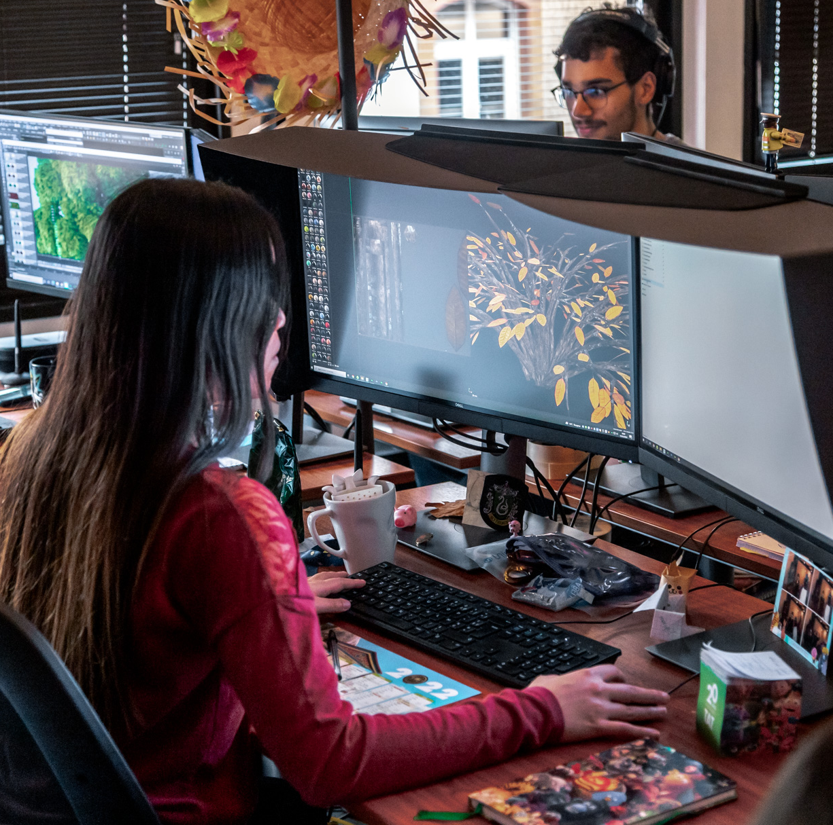
“The Lenovo servers provide an easy-to-manage resource, giving our digital artists the computational power they need to transform their artistic visions into highly polished video content.”
Boualem Nouri
IT Manager, TAT Productions

Slide 8
3
With Lenovo ThinkSystem, TAT can power through its heavy computation and simulation workloads and create digital content that brings joy to millions of viewers worldwide—without IT management complexity.
"The real advantage with Lenovo is the XClarity management tool," says Boualem Nouri. "For our workloads, performance is almost entirely dependent on the CPU and memory, which don't vary between different server manufacturers. What makes the difference in favor of Lenovo is XClarity—compared to tools from other vendors, the difference is night and day."
80% time saving in server updates
Results
Centralized configuration
Exceptional reliability

Slide 9
Efficient management
Lenovo XClarity empowers TAT to remotely manage its ThinkSystem servers—hosted 13 km from its offices in Toulouse—from a single point of control.
“If the servers need a firmware security update, I can do that once and automatically apply it to all 40 servers,” says Boualem Nouri. “Similarly, if we need to activate an option in the BIOS, it's a single operation for all servers. With other servers in our render farms, I have to apply changes to each server in turn. It's easily an 80% time saving with Lenovo XClarity for these kinds of updates.”

Slide 10
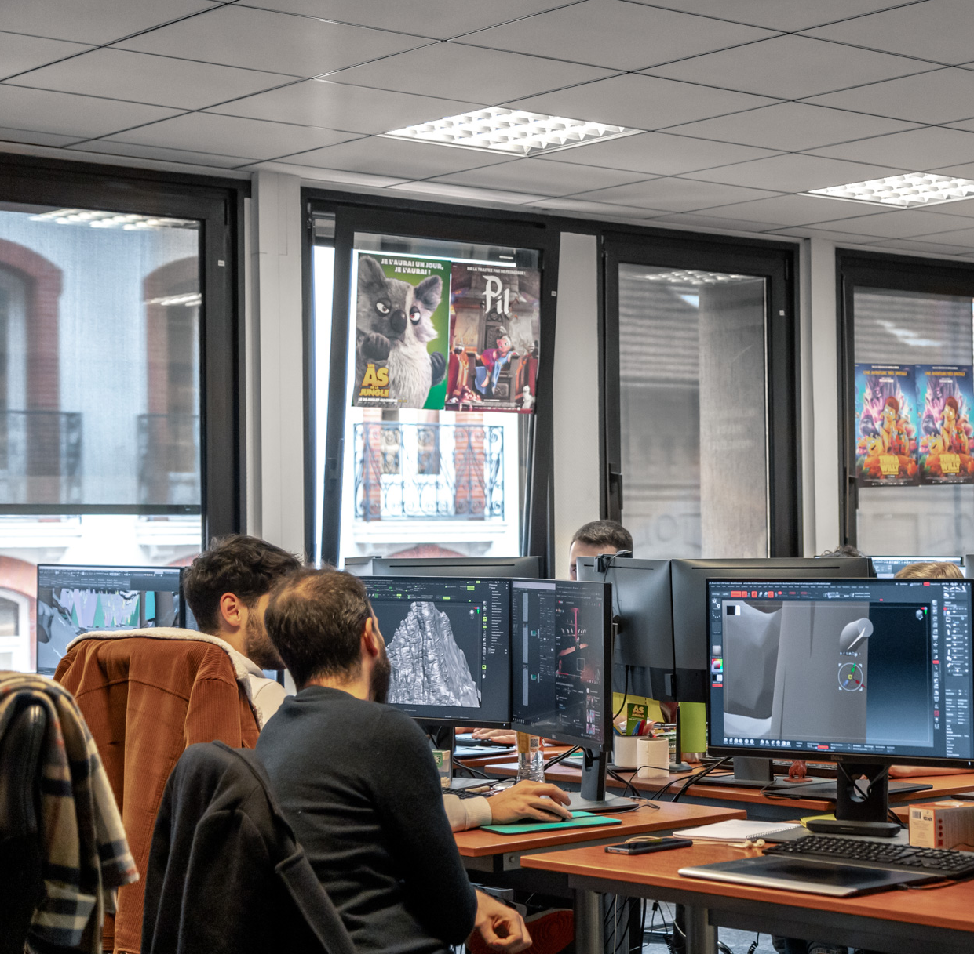
“With Lenovo XClarity, we have full visibility of all our servers and advance warning of any potential problems such as overheating. We place intense demands on these machines, so it's great to have a global overview of server health.”
Boualem Nouri
IT Manager, TAT Productions

Slide 11
Why Lenovo?
"Whenever we add new servers, we always look at the whole market and make sure we're getting the best value for our requirements," says Boualem Nouri. "But in terms of the quality of administration tools, Lenovo is still clearly far ahead of the competition. That's a very significant added value, and in those terms, I can easily understand why Lenovo is the global number one in servers."

Slide 12
How can animation studios bring joy to global audiences?
Lenovo ThinkSystem servers help TAT's digital artists transform their creative ideas into compelling TV and movie content.
Explore Lenovo ThinkSystem Solutions
Lenovo and the Lenovo logo are trademarks or registered trademarks of Lenovo. © Lenovo 2024. All rights reserved.

